Slide 1
IMPLEMENTATION OF AUDIO COMPRESSION AND DECOMPRESSION USING DELTA MODULATION
JENISH K - URK22EC4020
JEFFERSON DANIEL - URK22EC 4001

Slide 2
Outline
Introduction
Market Survey
Methodology
Results and Discussions
Conclusions
References
Acknowledgements

Slide 3
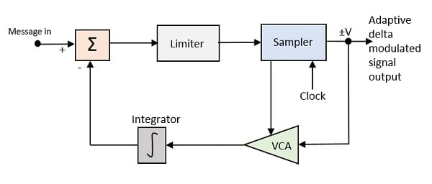
Introduction
Delta Modulation (DM) is a simple form of audio compression where each sample is encoded as a difference (delta) from the previous sample, rather than as an absolute value.
This process can result in significant data compression, especially when the signal has gradual changes.
Audio compression using Delta Modulation in Python involves processing each sample as a delta (difference) from the previous one, then encoding this delta as a single bit.

Slide 4
Problem Statement
Audio data often requires significant storage and bandwidth.
Compression techniques, like Delta Modulation (DM) and Differential Pulse Code Modulation (DPCM), can efficiently reduce file size.
Delta modulation uses a simpler encoding and decoding process compared to DPCM. Delta Modulation encodes the signal by just tracking changes (whether the signal goes up or down) instead of encoding the full difference from the previous sample.
Delta modulation only transmits one bit per sample, which can help in reducing bandwidth requirements. In contrast, DPCM often requires more bits to represent the sample difference, especially if the signal changes rapidly.

Slide 5
Implementation
Delta Modulation (Compression)
For each sample, compute the difference from the previous sample.
Encode each difference as a binary value (1 for positive change, 0 for negative change), storing only changes, not absolute values.
2. Delta Demodulation (Decompression)
Using the binary values, reconstruct the audio signal by cumulatively adding or subtracting a fixed step size based on the encoded bit (1 or 0).
s

Slide 6
Expression
The basic expression can be represented as:
𝑠[𝑛]=𝑠[𝑛−1] + Δ⋅𝑑[𝑛]𝑠[𝑛] = 𝑠[𝑛 −1] + Δ⋅ 𝑑[𝑛]
Where:
𝑠[𝑛] = current sample value
𝑠[𝑛−1] = previous sample value
𝑑[𝑛] = delta modulation output (1 or 0)

Slide 7
Market Survey
Target Sectors :
The audio compression market is expanding due to increasing demand for efficient storage, streaming, and real-time audio transmission.
Companies like Fraunhofer (AAC), Dolby (AC-4), and Qualcomm (AptX) dominate advanced audio compression markets, primarily focusing on high-fidelity audio for music, streaming, and media.
Current Compression Techniques :
Lossy compression methods like MP3 and AAC are popular for general audio, using perceptual encoding to reduce file sizes by discarding inaudible data, making them widely used in music streaming and downloads.
For users seeking high audio fidelity, lossless codecs like FLAC and ALAC offer compression without quality loss, though the files remain larger than their lossy counterparts.

Slide 8
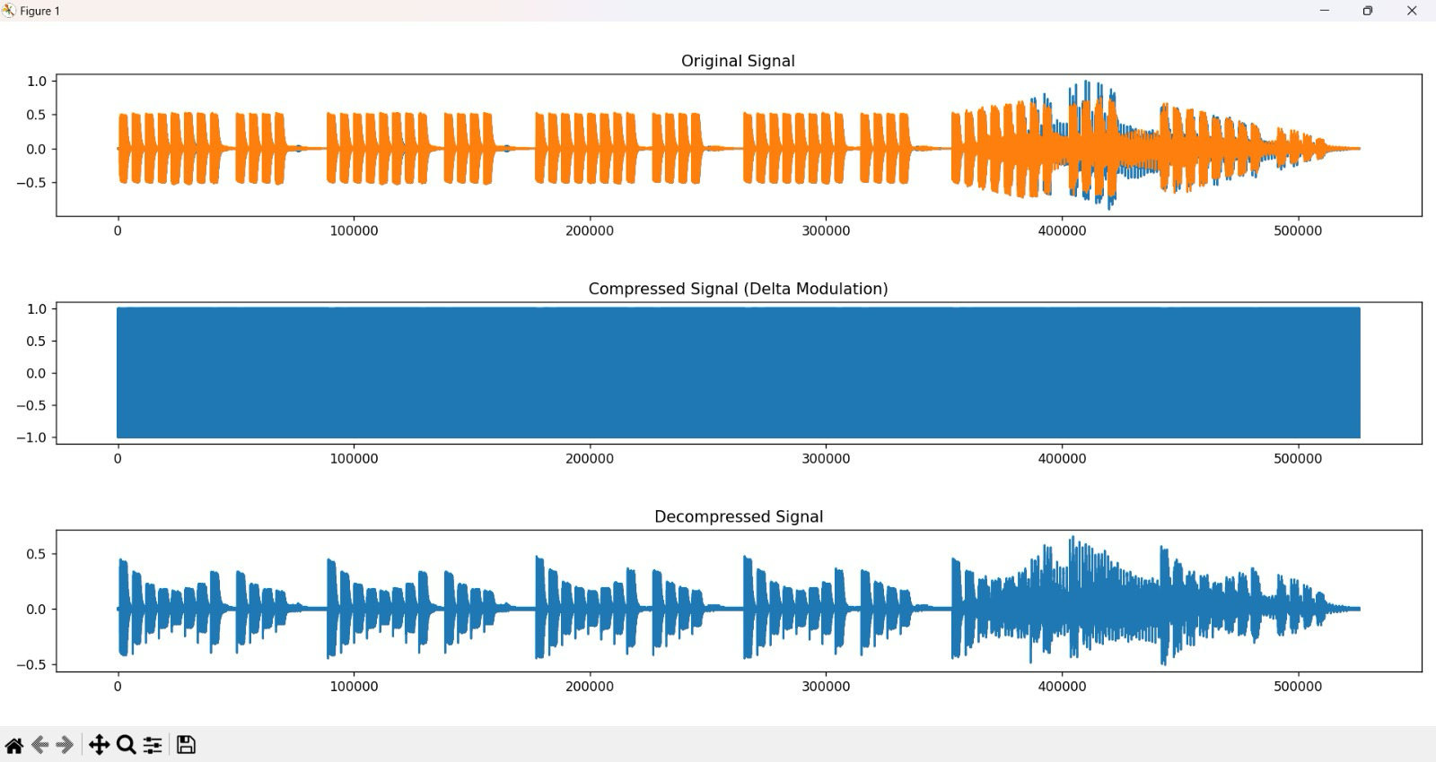
Results and Discussions

Slide 9
Conclusion
Delta Modulation (DM) proves to be a simple yet effective method for audio compression, particularly for signals with gradual changes, such as voice data.
Its low computational complexity makes it well-suited for embedded systems, real-time applications, and low-power devices.
Delta Modulation’s efficiency in reducing data size supports storage and transmission needs in scenarios with limited resources, making it valuable for applications like telecommunications and IoT devices.

Slide 10
References
https://pysdr.org/content/digital_modulation.html

Slide 11
Acknowledgements
We acknowledge our gratitude and thank to our faculty, friends and my family members for their constant encouragement.

